Slide 1

Fuzzy Support Vector Machines for Pattern Classification
Takuya Inoue and Shigeo Abe Graduate School of Science and Technology, Kobe University, Kobe, Japan E-mail: abeeeedept . kobe-u. ac. j p
Notes:
줄 간격 + 페이지 번호

Slide 2
Table of Contents
1. Introduction
2. Two-Class Support Vector Machines
3. Multiclass Support Vector Machines
4. Fuzzy Support Vector Machines
5. Performance Evaluation
6. Conclusions

Slide 3
1. Introduction
=> conventional support vector machines (SVM)
n-class problem -> n two-class problems
(For the ith two-class problem -> One-vs-Rest)
datum is classified into class i
-> only when the value of the ith decision function is positive.
datum is unclassifiable
-> when the value of more than one decision function are positive or all the values are negative.
=> pairwise classification method
n(n-1)/2 decision functions -> unclassifiable regions remain.
=> fuzzy support vector machines(FSVM)
Using the decision functions obtained by training the SVM,
for each class, we define a truncated polyhedral pyramidal membership function.
->classification is same. generalization ability of the FSVM is the same with or better than that of the SVM
->three benchmark data sets，demonstrate the superiority of the FSVM over the SVM.

Slide 4

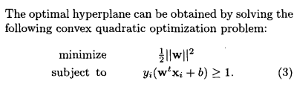

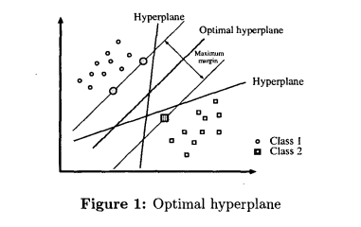
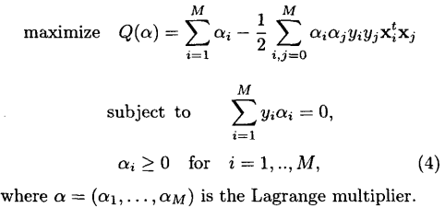
2. Two-Class Support Vector Machines

Slide 5
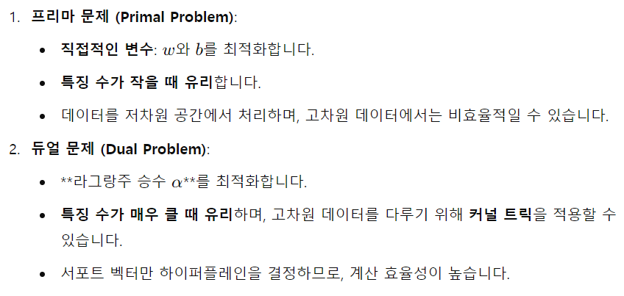
2. Two-Class Support Vector Machines

Slide 6
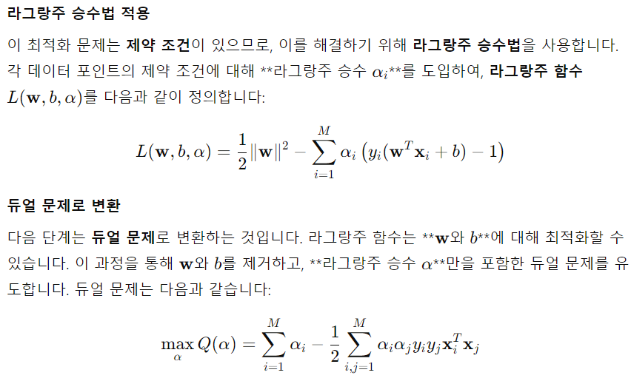
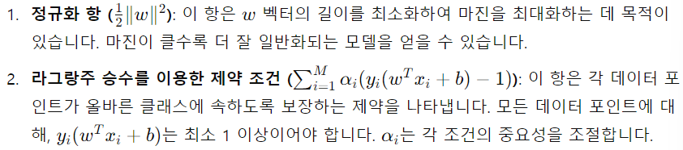
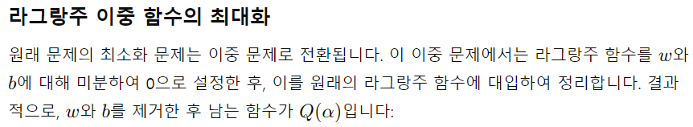
2. Two-Class Support Vector Machines

Slide 7
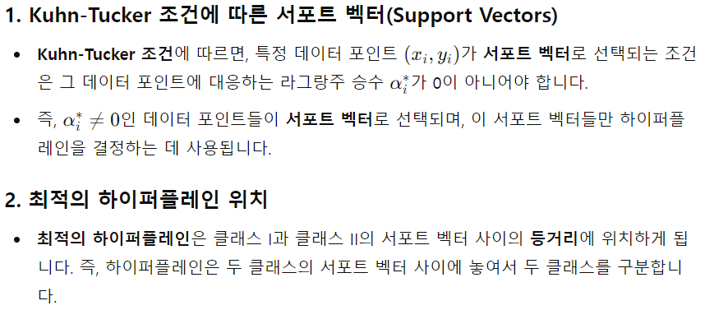
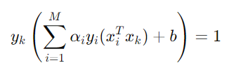
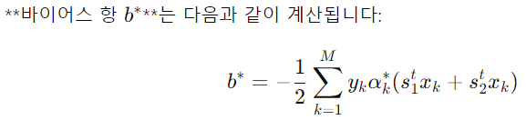
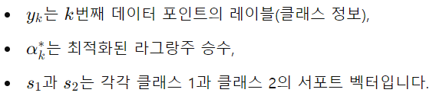
2. Two-Class Support Vector Machines
<서포트 벡터에서의 결정함수>

Slide 8
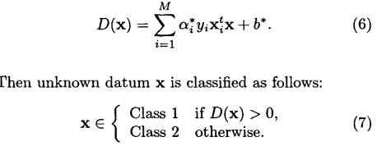
2. Two-Class Support Vector Machines

Slide 9
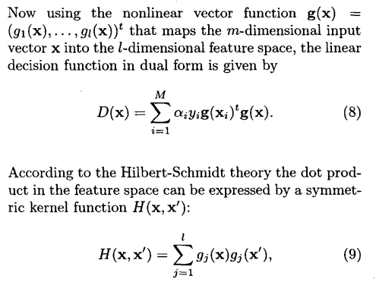
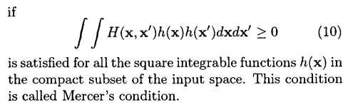
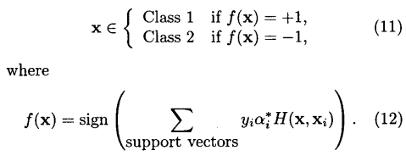
2. Two-Class Support Vector Machines

Slide 10

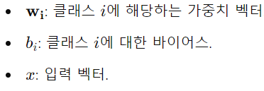
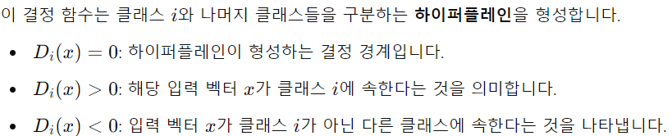

3. Multiclass Support Vector Machines

Slide 11
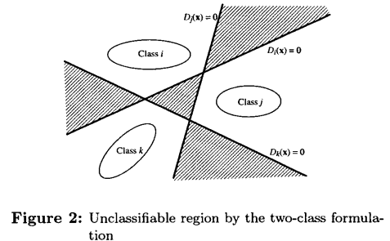
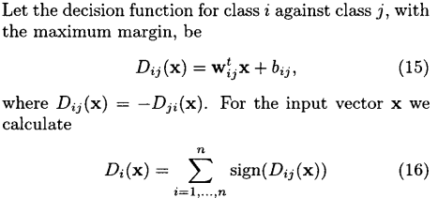

3. Multiclass Support Vector Machines

Slide 12
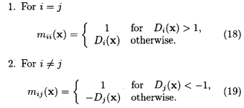
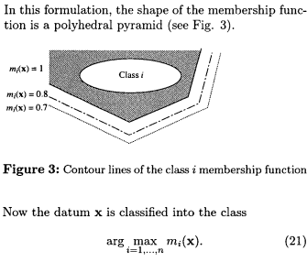
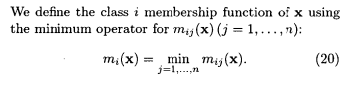
4. Fuzzy Support Vector Machines

Slide 13
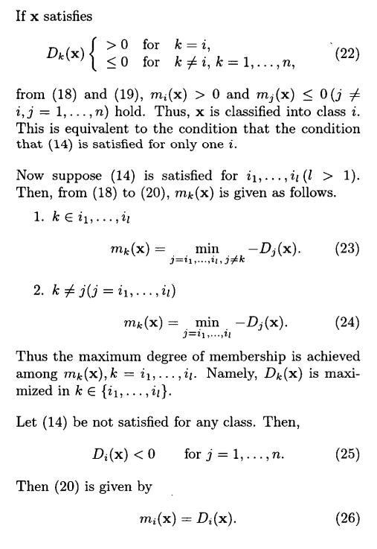
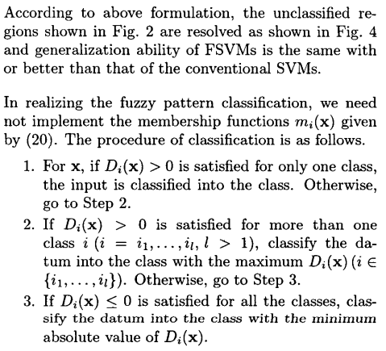
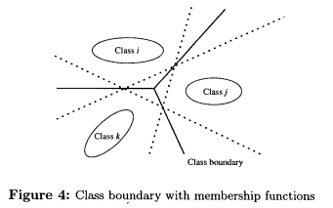
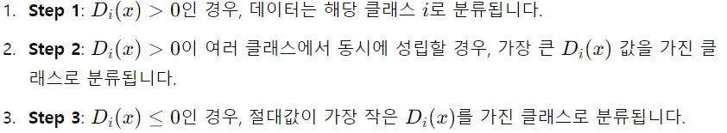
4. Fuzzy Support Vector Machines

Slide 14
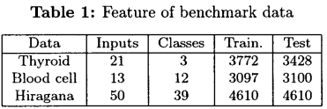
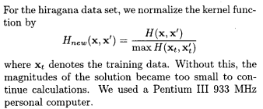
5. Performance Evaluation

Slide 15
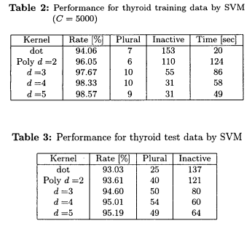

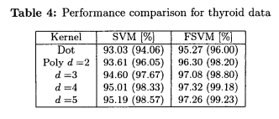
5. Performance Evaluation

Slide 16
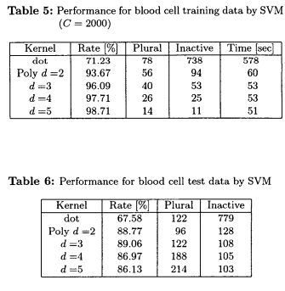
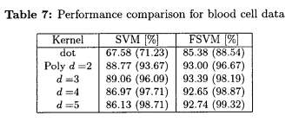
5. Performance Evaluation

Slide 17
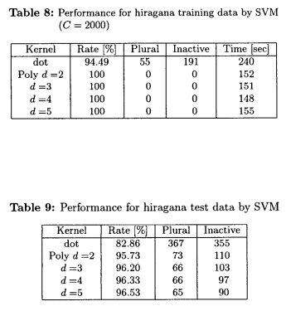
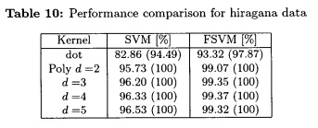
5. Performance Evaluation

Slide 18
6. Conclusions
we proposed FSVM for classification that resolve unclassifiable regions caused by conventional SVM.
The generalization ability of the fuzzy SVM is superior to that of the conventional SVM.

Slide 19
Thank You For Listening.

